Slide 1
DLNA CVP-2 Overview for W3C
Premium content on any device, in any room

Slide 2
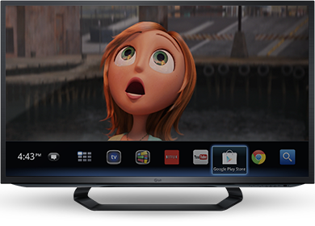
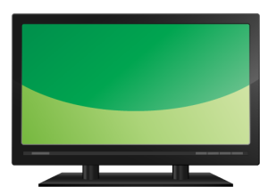
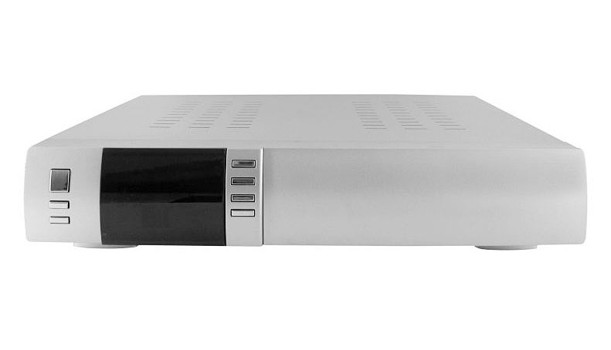
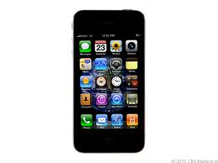
DLNA CVP-2 Guidelines and Test
Premium content on any device, in any room with consistent service provider UI
Laptop
Tablet
Smart TV
Wi-Fi
Ethernet
MoCA
HomePlug AV
HD-PLC
HPNA
Wi-Fi Direct
Service Provider
Set Top Box/Gateway
Game Console
Smart Phone
Blu-Ray Player
Notes:
CVP-2 Benefits:
Enables streaming of service provider content (e.g. live, on-demand, DVR) to retail devices (e.g. televisions, PCs, phones, tablets, Blu-ray disc players, and game consoles) with consistent service provider user interface across all CVP-2 devices from different manufacturers
Preserves the rights of content providers
Allows access to all service provider services in every room without the need for service provider supplied STBs in every room

Slide 3
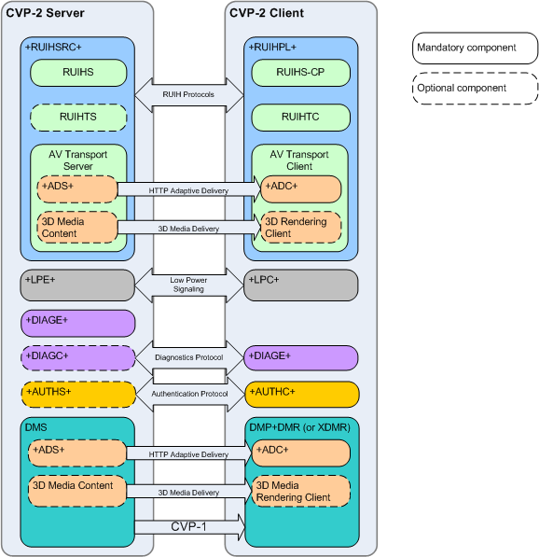
DLNA CVP-2 Guidelines and Certification
Multi-Industry Effort in DLNA
Development Led by:
Status:
Technical Specifications to be published in March 2014
Certification launch scheduled for end of September 2014
Notes:
CVP-2 Features:
HTML5 RUI
Authentication of DLNA Certification (using DTCP-IP keys)
Diagnostics
Networked Devices Power Save (Low Power)
HTTP Adaptive Delivery (MPEG-DASH)
MPEG-2 and AVC Video in MPEG-2 TS and MP4 containers
ETV, Ad-Insertion & other TV Services signaling in MPEG2-TS
3D Media Formats (conditionally mandatory for devices supporting 3D video)
Multi-Industry effort in DLNA:
Development led by service providers in conjunction with CE manufacturers and technology suppliers (Broadcom, BSkyB, CableLabs, Comcast, Cox, Time Warner Cable, Samsung)
Acronyms:
+RUIHSRC+: HTML5 RUI Server Capability
+RUIHPL+: HTML5 RUI Pull Controller
RUIHS: UPnP HTML5 RUI Server Service
RUIHS-CP: UPnP HTML5 RUI Server Service Control Point
RUIHTS: HTML5 RUI Transport Server
RUIHTC: HTML5 RUI Transport Client
ADS: Adaptive Delivery Server
ADC: Adaptive Delivery Client
DMP: Digital Media Player
DMR: Digital Media Renderer
XDMR: Extended DMR
DIAGE: Diagnostics Endpoint
DIAGC: Diagnostic Controller
LPC: Low Power Controller
LPE: Low Power Endpoint
AUTHS: Authentication Server
AUTHC: Authentication Client

Slide 4
DLNA CVP-2 Specification Features
NO NEW APIs – Using standard W3C APIs
Baseline: CVP-1 Features: DMP+DMR, DTCP-IP Link Protection, HTTP Transport w/ Trick Modes, Priority-Based QoS, MPEG-2 & AVC Video in MPEG-TS
HTML5 RUI
Includes mapping for MSO TV services (closed captions, Ad-Insertion, SAP, etc.) signaling in MPEG2-TS
Authentication of DLNA Certification (using DTCP-IP keys)
Diagnostics
Networked Devices Power Save (Low Power)
HTTP Adaptive Delivery (MPEG-DASH)
MPEG-2 and AVC Video in MPEG-2 TS and MP4 containers
3D Media Formats (conditionally mandatory for devices supporting 3D video)

Slide 5
CVP-2 Hybrid In-home + Cloud Scenario
Cloud HTML5 RUI/Server
2. HTML5 RUI Guide
3. Linear, On-Demand, DVR Content
Home Network
DLNA CVP-2 TV
CVP-2 STB/ Gateway
1. Device and Service Discovery
Notes:
RUI Server and Authentication Server component are located in the cloud
Only A/V Server component is in the service provider supplied STB in the home
Architecture that provides transition path for cloud to ground (or All-IP) content delivery

Slide 6
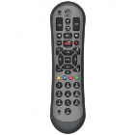
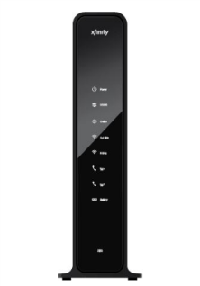
Live Linear Streaming
6. Settop tunes channel and streams content to COAM device
HDMI
Hybrid STB
Account Server
1. User enables DLNA via STB UI
RUI Server
2. STB publishes RemoteUIServer Service
3. COAM User Agent discovers and parses UI listing and loads and launches RUI
4. RUI reserves STB tuner
5. RUI calls play on HTMLMediaElement, which causes COAM User Agent to send HTTP HEAD/GET requests to STB
CVP-2 Certified
COAM Device
Data Gateway

Slide 7
Questions
Contact: Amol Bhagwat
a.bhagwat@cablelabs.com
303-661-3333

